Slide 1


AutoMAX

Slide 2



Personal Background
(Name, Past Experience, Qualification, Career Summary)
Name : Ravipati Jayanth Babu
Past Experience : Fresher – Recently joined Coforge as a Graduate Engineer Trainee
Qualification : Bachelor of Technology (B.Tech)
Career Summary : A passionate engineering graduate with a strong interest in automation and digital transformation. Currently building foundational experience at Coforge as a Graduate Engineer Trainee, with a focus on learning and contributing to enterprise-grade automation solutions.
www.collaberadigital.com

Slide 3
Personal Background
(Name, Past Experience, Qualification, Career Summary)
Name : Madala Anjali
Past Experience : Fresher – Recently joined Coforge as a Graduate Engineer Trainee
Qualification : Bachelor of Technology (B.Tech)
Career Summary : Dedicated and self-motivated individual starting her professional journey at Coforge. Interested in software development and automation with a commitment to continuous learning and contributing to team success.
www.collaberadigital.com

Slide 4
Personal Background
(Name, Past Experience, Qualification, Career Summary)
Name : Shaik Nazir
Past Experience : Fresher – Recently joined Coforge as a Graduate Engineer Trainee
Qualification : Bachelor of Technology (B.Tech)
Career Summary : A quick learner and team player currently training at Coforge. Passionate about exploring innovative solutions in automation and aiming to build a strong technical foundation to support enterprise needs.
www.collaberadigital.com

Slide 5
Personal Background
(Name, Past Experience, Qualification, Career Summary)
Name : Pathuri Suharsha
Past Experience : Fresher – Recently joined Coforge as a Graduate Engineer Trainee
Qualification : Bachelor of Technology (B.Tech)
Career Summary : An enthusiastic learner with a keen eye for problem-solving and system efficiency. Recently joined Coforge and looking forward to applying technical knowledge in real-world projects and growing within the automation domain.
www.collaberadigital.com

Slide 6
Personal Background
(Name, Past Experience, Qualification, Career Summary)
Name : Mohammad Farhan
Past Experience : Fresher – Recently joined Coforge as a Graduate Engineer Trainee
Qualification : Bachelor of Technology (B.Tech)
Career Summary : Detail-oriented and curious by nature, Farhan has recently begun his professional career at Coforge. He is eager to explore automation tools and technologies, aiming to bridge theoretical knowledge with practical applications. Committed to continuous learning and innovation in a dynamic work environment.
www.collaberadigital.com

Slide 7

Key Takeaways/Learnings from the Program (HTD)
✅ Gained hands-on experience in automation testing using real-time projects
🌀 Improved understanding of STLC, and agile methodologies
🧪 Learned to write and execute test cases and scenarios effectively
⚙️ Gained confidence in working with tools like Selenium, TestNG, and Maven
🔁 Understood end-to-end automation workflows and CI/CD pipeline basics
🤝 Improved collaboration and communication in a team environment
🧩 Built problem-solving and debugging skills through practical challenges
🗂️ Learned to work with version control tools like Git and GitHub

Slide 8

Problem Statement of the AutoMax Project
The manual testing process of the MaxFashion e-commerce website was time-consuming, error-prone, and inefficient, especially as the platform scaled with more features and frequent updates. There was a need for a robust automation solution to:
✅ Improve test coverage across key modules like login, product selection, and checkout
⚠️ Reduce human error and repetitive manual work
🔁 Enable faster feedback during development cycles
🧪 Ensure consistent and reliable regression testing
🚀 Enhance the overall quality and performance of the application
Automation was critical to support continuous delivery, improve productivity, and ensure a seamless user experience across all shopping categories.

Slide 9

Modules Implemented in the AutoMax Project
We automated several key modules of the MaxFashion website, focusing on core functionalities that are critical to user experience and business workflows. The modules include:
Login Module:
Automates user login process
Valid and invalid credentials tested
Validates error messages and redirection
Women Product Module:
Navigates to women’s section
Applies filters (e.g., brand, price)
Selects products and adds to cart
Men Product Module:
Navigates to men’s section
Applies filters and sorts products
Adds selected items to cart

Slide 10

Modules Implemented in the AutoMax Project
Kids Product Module:
Tests kids category navigation
Validates product details and interactions
Adds items to cart with selected options
Checkout Module:
Validates cart summary
Handles address and payment entry
Completes order and confirms success

Slide 11

Tools and Technologies Used
To implement automation in the AutoMax Project effectively, we used the following tools and technologies:
Selenium WebDriver – for browser-based automation
TestNG / JUnit – for test management and assertions
Maven – for project build and dependency management
Java – as the programming language for writing scripts
Extent Reports – for generating readable test reports
Git – for version control and collaboration
Jenkins – for continuous integration and running automated builds

Slide 12

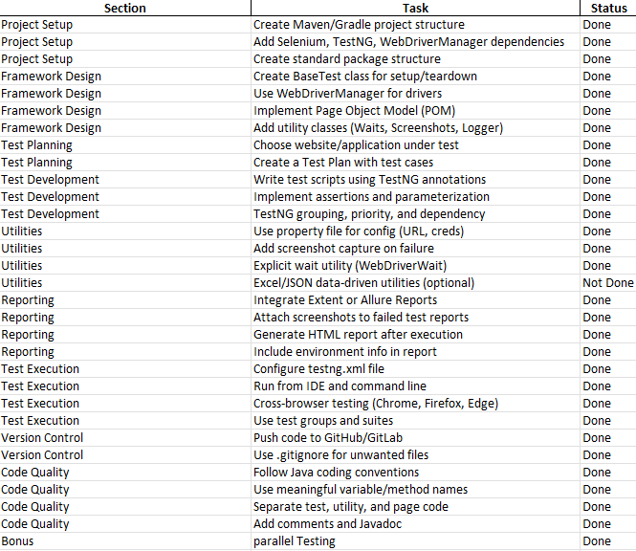
AutoMax – Automation Testing Capstone Checklist

Slide 13
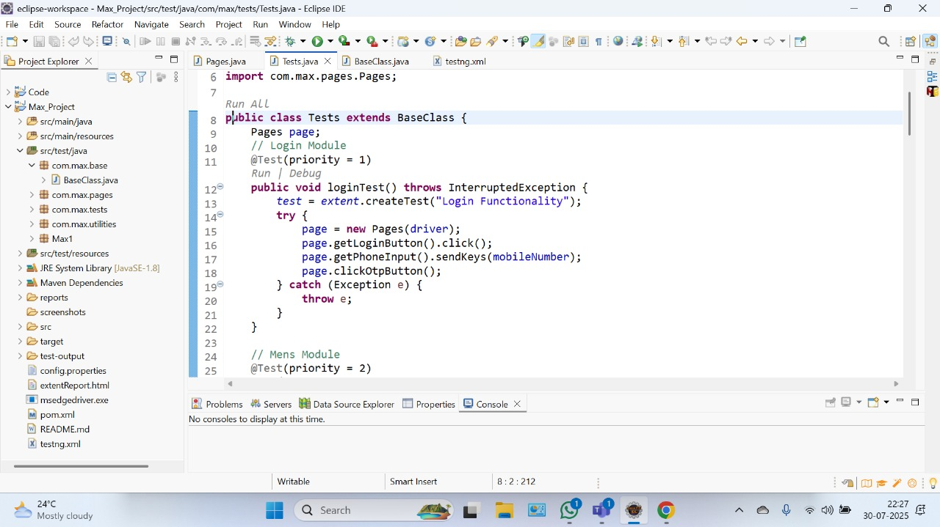
Important areas of the Project with screenshots
Login Module :-

Slide 14
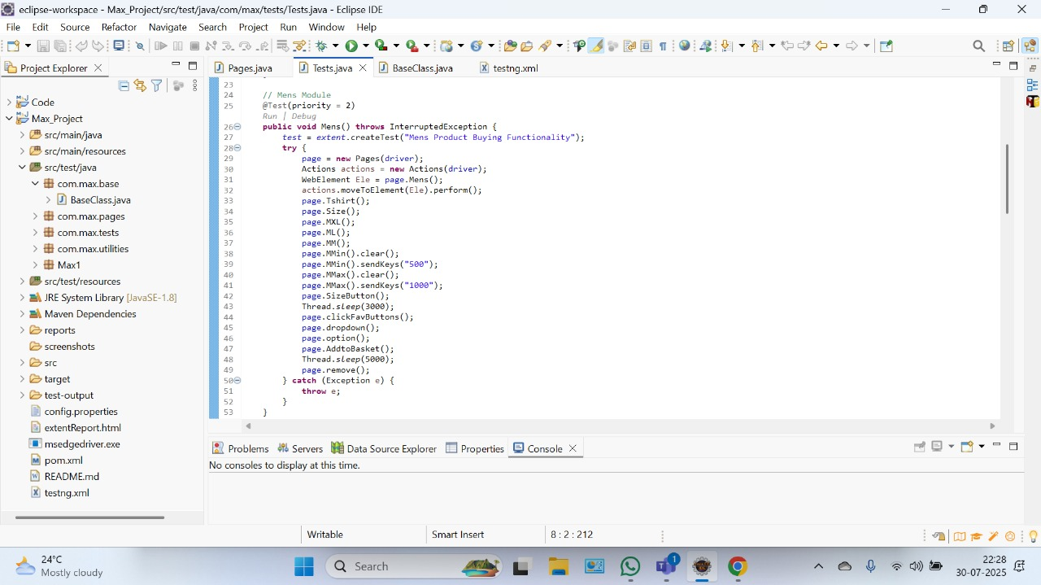
Important areas of the Project with screenshots
Mens Module :-

Slide 15
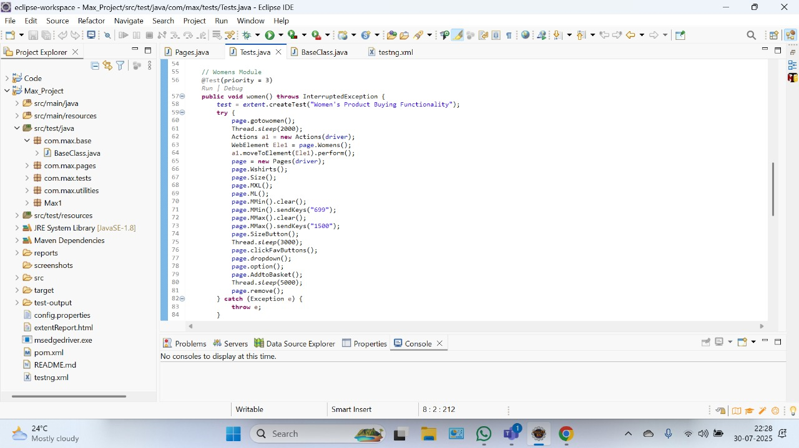
Important areas of the Project with screenshots
Womens Module :-

Slide 16

Important areas of the Project with screenshots
Kids Module :-

Slide 17
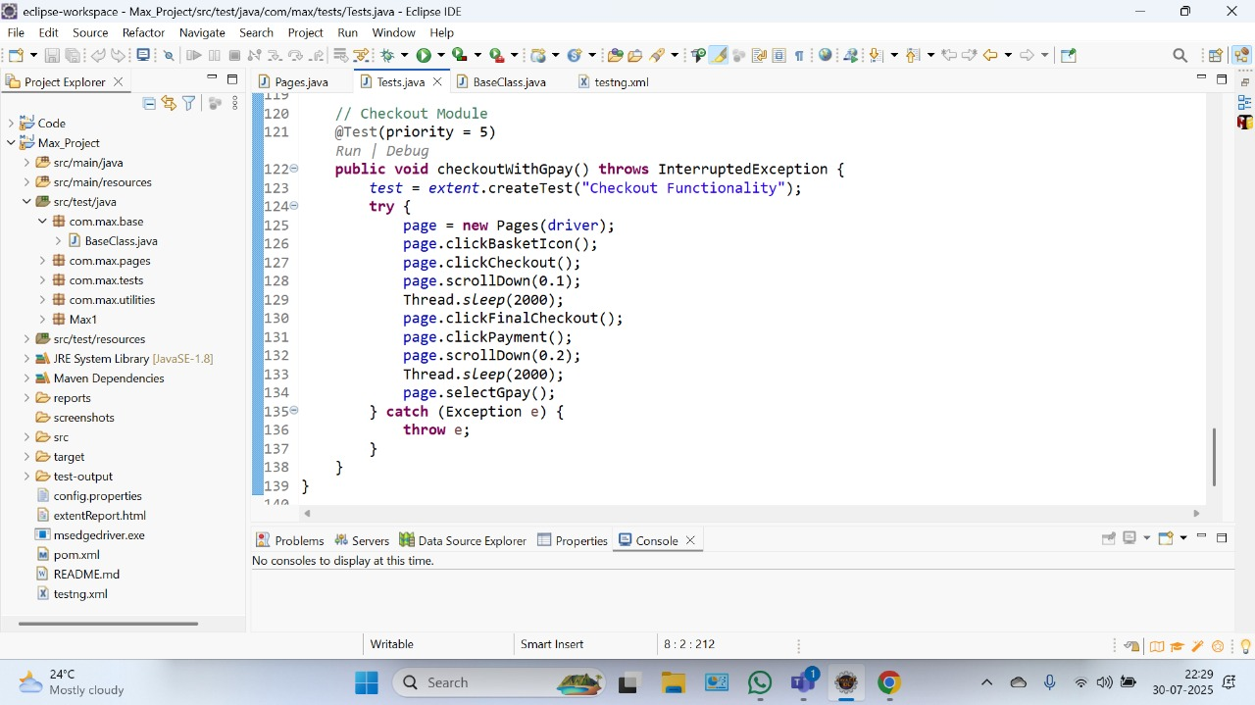
Important areas of the Project with screenshots
CheckOut Module :-

Slide 18
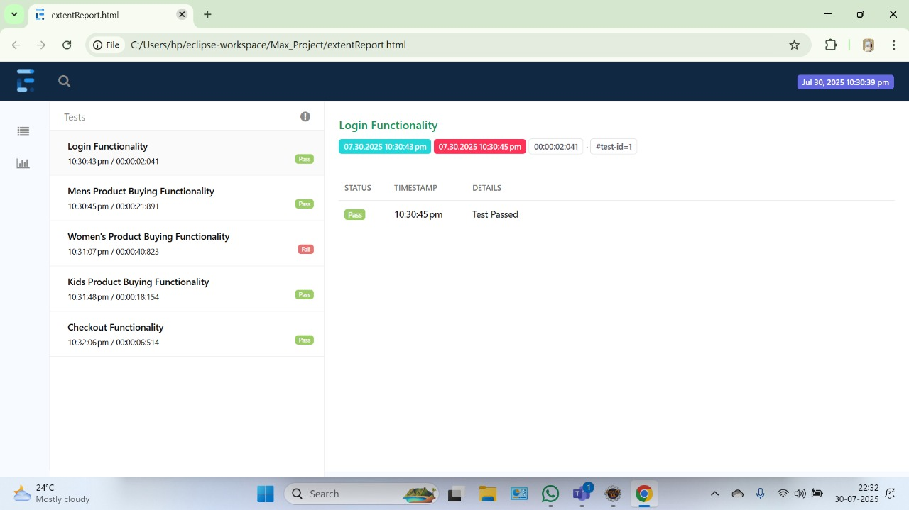
Important areas of the Project with screenshots
Extent Report Overview :-

Slide 19
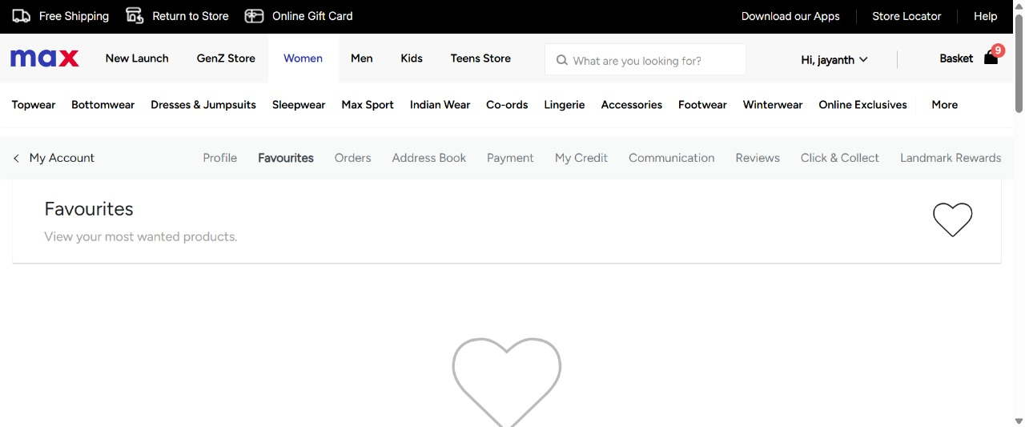
Important areas of the Project with screenshots
Failed Test Case:-

Slide 20
🖥️Conclusion – Part 1: Technical Outcomes
✅ Automated major modules of MaxFashion: Login, Women, Men, Kids, and Checkout
🧪 Created end-to-end test scripts covering both positive and negative scenarios
⚙️ Built a modular, maintainable automation framework using:
-> Selenium WebDriver
->TestNG
->Maven
->Java
📄 Implemented Page Object Model (POM) for reusability and better code structure
📊 Integrated TestNG for execution and reports for result analysis
🔁 Enabled faster regression cycles and reduced manual testing time
🗂️ Managed test data and configurations using Excel and property files

Slide 21
👥 Conclusion – Part 2: Professional Learnings
🤝 Improved collaboration skills through team-based development and Git usage
🧠 Gained real-world exposure to automation frameworks and defect handling
🛠️ Developed problem-solving and debugging skills in live project scenarios
📈 Understood the complete test life cycle from planning to reporting
🧩 Learned how to build scalable test structures for long-term projects
🔍 Practiced writing clean, readable, and well-organized code
🚀 Gained confidence to handle real-time client tasks and interviews

Slide 22

Thank You

